Slide 1
2018
Disability Access Committee
Kim Karwal, Rural Rehabilitation and Assistive Technology Coordinator

Slide 2
Easterseals Iowa
Assistive Technology Program

Slide 3
What is Assistive Technology
Assistive Technology is defined as any piece of equipment, product system, or service used to increase, maintain, and/or improve functional capabilities of individuals with disabilities or limitations (ATIA, 2017).
Assistive Technology can range from low-tech to high-tech depending on the need and implementation.

Slide 4
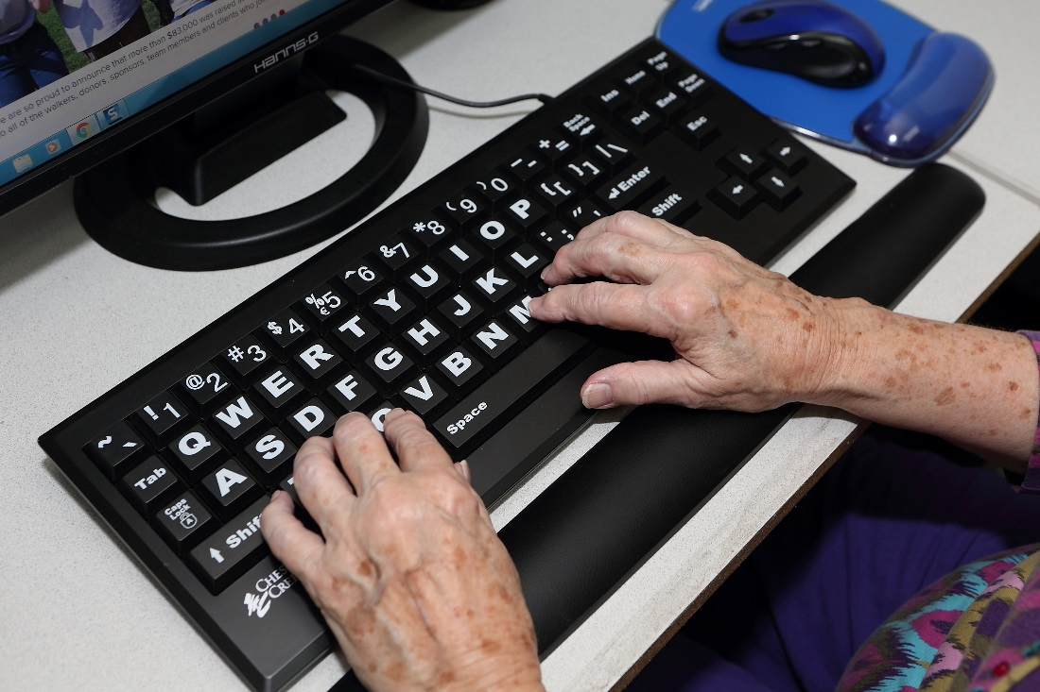
Assistive Technology Implementation
This overview on implementation is not entirely inclusive, only an introduction to Assistive Technology implementation.
Avoid AT abandonment by determining what is working and in what environment it works before purchasing.

Slide 5
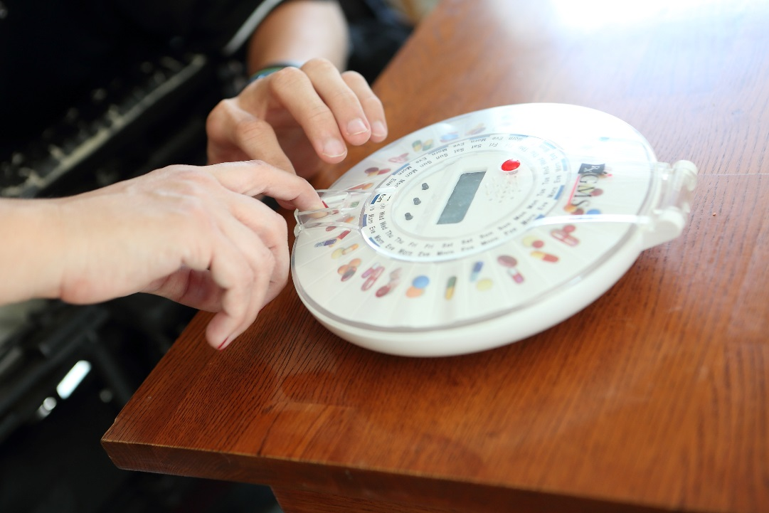
Assistive Technology Implementation
No one device is a solution for everyone, AT is very individualized and should be approached on an individual basis of need.
Look at the individual’s abilities, the environment the device(s) would be utilized in and the task or goal.
Abilities
Task
Environment

Slide 6
Abilities
What can the individual do independently?
What –specifically- does the individual needs support with?
*Eating= entire support or only cutting
*Communication= shy, unable to communicate, need support with appropriate prompts
*Reading = vision limitation, dyslexia, reading level
Are there certain times that abilities change? {Illness, with medications, other}
Does the individual desire to be independent with specific tasks?

Slide 7
Environment
Where is the task being performed?
At home
In the park
At work
At school
At Camp
At Easter Seals
Anywhere else?

Slide 8
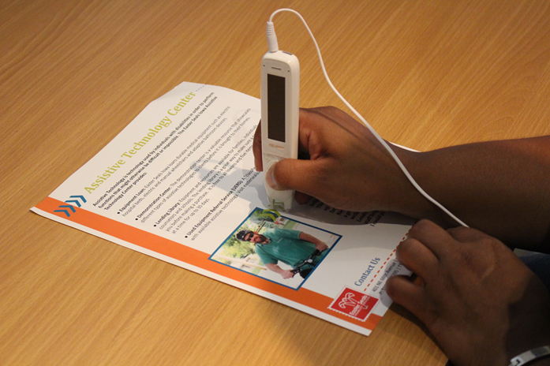
Task
How is the task performed now? Has it been performed differently in the past? What has worked? What aspects are not working? Is there a physical barrier, learning barrier, attitudinal barrier?

Slide 9
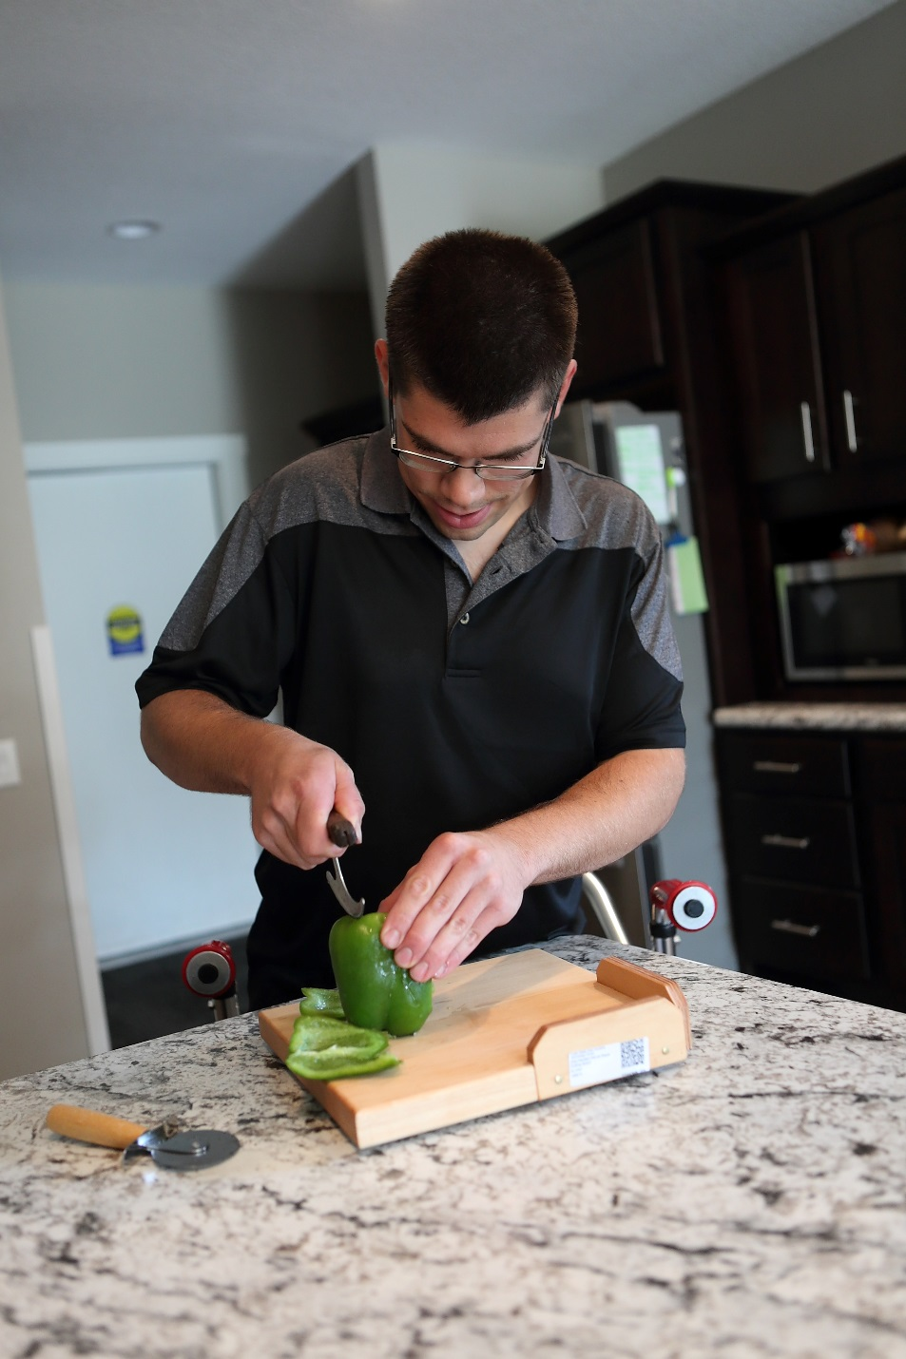
Easterseals Iowa
Providing exceptional services to ensure that all people with disabilities or special needs and their families have equal opportunity to live, learn, work, and play in their communities.

Slide 10
Easterseals Iowa Assistive Technology Program
State AT Implementing Entity
Serving all ages in all areas of Iowa
Information and Referral
Demonstration Center
Durable Medical Equipment Loan Program
Lending Library
AT Exchange

Slide 11
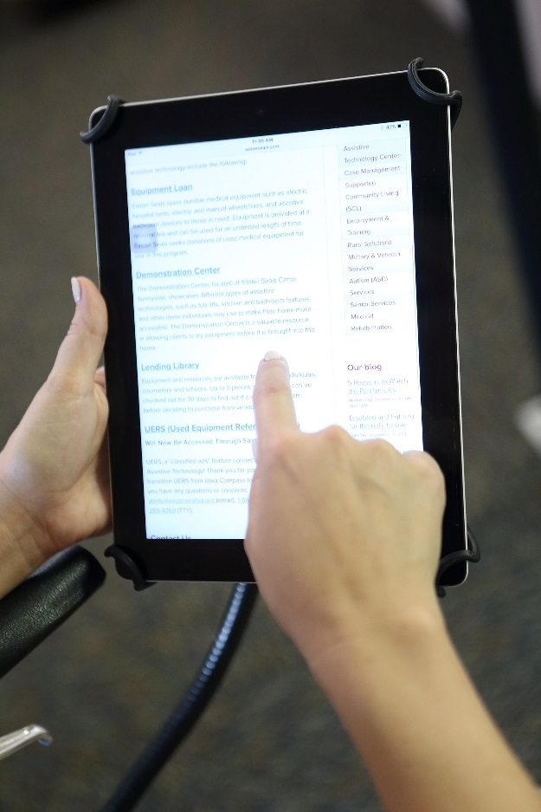
Information and Referral
Contact us for any Assistive Technology related questions, concerns, or needs!

Slide 12
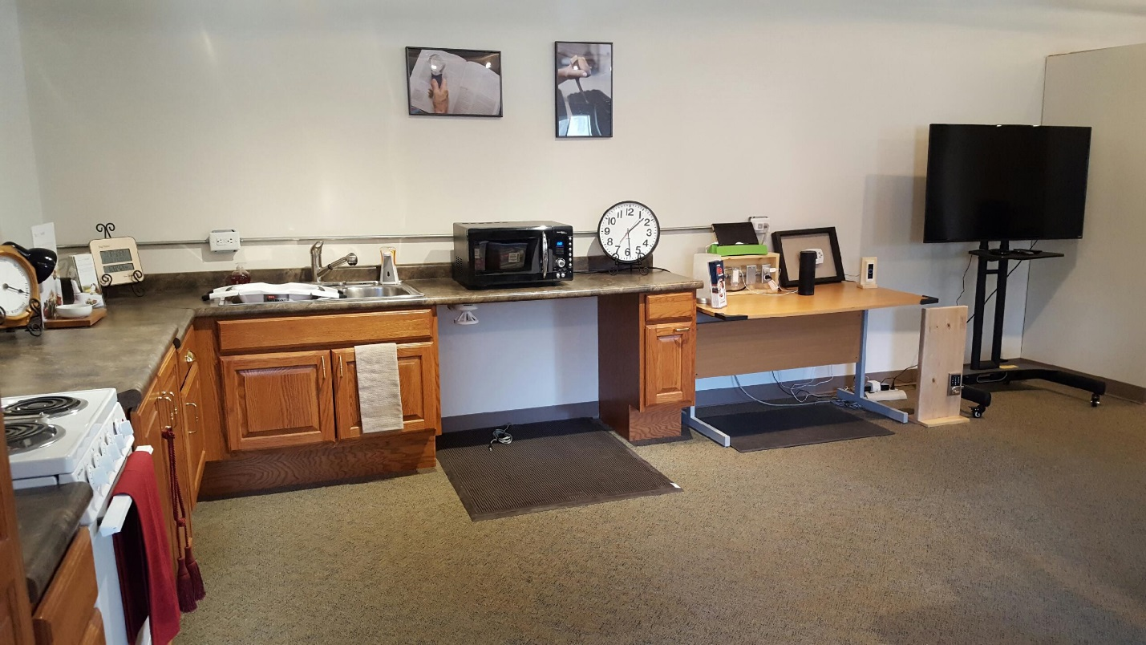
Demonstration Center
Demonstration Center includes:
Dropped countertop kitchen
Adaptive kitchen cupboards
Adjustable height desk
Amazon Alexa and accessories

Slide 13
Durable Medical Equipment Loan
Runs solely off of donated durable medical equipment: wheelchairs, walkers, shower benches, etc.
Sanitation and refurbishment by staff
Application for loan includes information from a Health Care Provider
Application available at www.easterseals.com/ia/at
Loans to Iowans with disabilities for nominal fee.

Slide 14
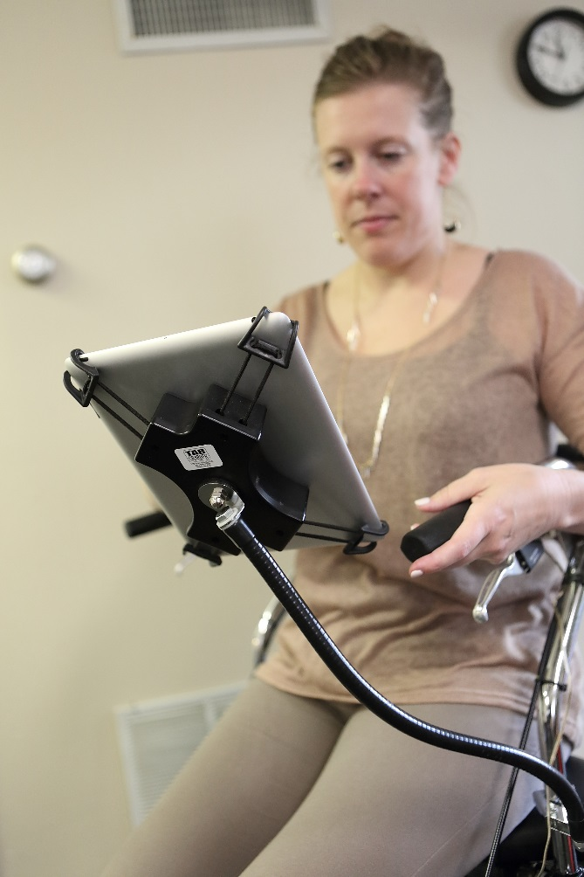
Lending Library
Consists of a variety of devices
Up to five devices loaned for 30 day trial period
Paper application available at www.easterseals.com/ia/at
Any Iowan with a disability, family member, or representative may borrow free of charge
Pursue our inventory at www.eastersealsia.at4all.com

Slide 15
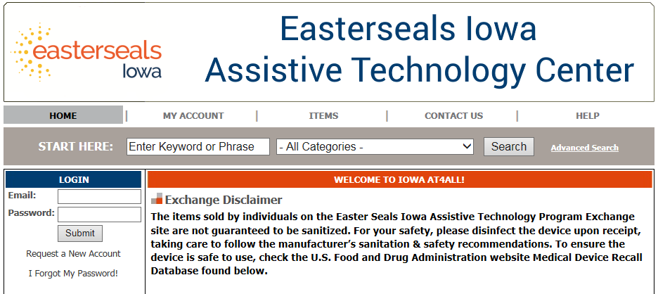
Iowa Assistive Technology Exchange
www.eastersealsia.at4all.com
Exchange (formerly known as UERS) is a “classified ads” feature that connects Iowans selling their durable medical equipment to Iowans in search of durable medical equipment.

Slide 16
Resources : JAN
Job Accommodation Network
www.askjan.org
Job Accommodation Network (JAN) is a source of free, expert, and confidential guidance on workplace accommodations and disability employment issues.

Slide 17
Resources: Iowa Compass
Iowa Compass Resource Database
Connects people with disabilities and complex health related needs to services and supports in their communities throughout Iowa.
Search engine for services and resources.
Tip Sheets including AT funding options, community resources, student rights, and frequently asked questions.
Center for Disabilities and Development
www.iowacompass.org
1-800-779-2001 (Toll Free)
711 (Relay)
Iowa-compass@uiowa.edu (Email)

Slide 18
Resources: The Iowa Able Foundation
Iowa Able Foundation
Statewide non-profit helping Iowans with disabilities and the aging achieve and maintain independence through micro lending programs and financial coaching.
www.iowaable.org
1-888-222-8943 (Toll Free)
711 (Relay)

Slide 19
Contact Easterseals Iowa
Phone: 1-866-866-8782
TTY: 515.289.4069
Email: atinfo@eastersealsia.org
Website: www.easterseals.com/ia/at
YouTube: Easter Seals Iowa Assistive Technology Center
LinkedIn: Easter Seals Iowa- Assistive Technology Center
Mail Chimp e-newsletter: http://eepurl.com/1DVMb
Follow Easter Seals Iowa on Facebook and Twitter

Slide 20
Questions?
Thank you.

