Slide 1
Month Date, Year
Disability Access Committee
Diane Hernandez, Disability Resource Coordinator

Slide 2
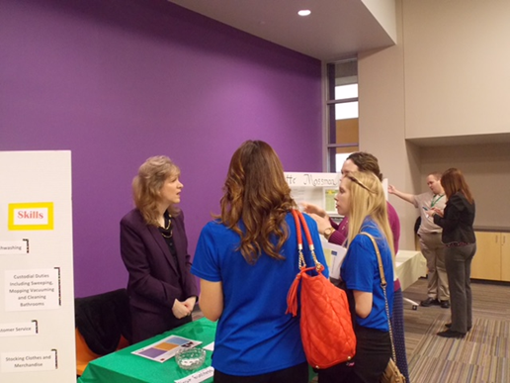
Reverse Job Fair – Turning the Tables
The Reverse Job Fair is an incredible opportunity for job seekers to showcase their skills, personality and ambition to employers. This is done by literally flipping the tables.
Job seekers develop presentations, displays, and materials and the employers circulate around the room learning about candidates.
This role reversal puts the job candidate in a position to design an experience that demonstrates their best attributes.

Slide 3
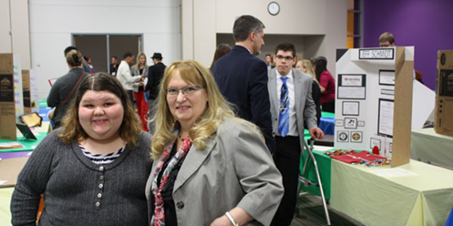
Benefits
To Job Seeker:
High quality portfolio to share, including resume, elevator speech, etc.
Practice developing presentation adapted to essential job functions.
Confidence!!!!
To Employer:
Connects businesses with high quality, but often overlooked, job seekers.
Requires less financial and logistical burden (no display).
Gets a chance to see job seekers’ strengths in a way that promotes creative thinking about hiring.

Slide 4
Step 1 Establish Team
EDRN – Employer’s Disability Resource Network
EDRN is a collaborative group of state, federal and community partners working together to identify, develop and mobilize resources, supports and services that add value to Iowa businesses hiring people with disabilities.
Our Team

Slide 5
Step 2 -- Establish a Plan
Essential to your success is creating a strong Work Readiness/Preparation
Component. There are a number of ways to do this, but we did a three-part process:
Day 1: Work Readiness Workshop – Clinic with stations for job seeking skill building
-- Preparation and one-on-one work with counselor --
Day 2: Dry Run – (Don’t miss this step)
Day 3: Reverse Job Fair – Let’s go get jobs!

Slide 6
Steps 3 – Identify Job Candidates
We decided that each partnering agency could bring 5 job seekers to the event.
Only bring as many candidates as you can support.
No criteria other than that the job seekers was willing and able to put the work in that is needed to be successful.
Job seekers complete application and release of information (have to have a tracking mechanism).
Review expectation with candidates.

Slide 7
Steps 4 -- Identify Employers/Sectors
Invite employers in job sectors that candidates are interested in.
Let them know the number of job seekers in their sector.
Have them provide job descriptions.
Send e-mails in every form: e-mails, in-person, phone calls, and calendar invites.

Slide 8
Step 5 -- Work Readiness Workshop
Stations
The Look – grooming, hygiene and what-to-wear
Interviewing – business partners perform mock interviews with candidates and provide immediate feedback
Resume and Application – Utilizing job descriptions provided by businesses who will be at the reverse job fair, job candidates receive assistance/suggestions on how to tailor their resumes
30-Second Elevator Speech – Using a cell phone, introductions are recorded and played back so job candidates can learn to make an impressive first impression
Display 101 – Each job candidates booth needs to be eye-catching and different – a unique way to showcase their talents.

Slide 9
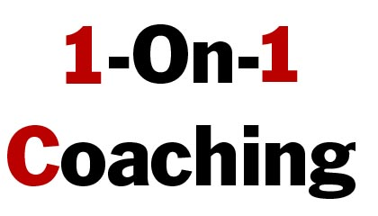
Step 6

Slide 10
Step 7 – Mock Job Fair/Rehearsal
Before mock job fair measure out space and make sure there is a good flow for tables.
Set up tables with colored tablecloths indicating sectors.
Create a handout for employers, explaining handouts.
Get agency and business partners to act as the “employers.”
Make sure job seekers know to arrive a minimum of one-hour before.
Think through EVERYTHING – parking, signage walking in.
This should be held approximately one week ahead (reminder to you to send out reminder notices to businesses about the actual job fair).

Slide 11
Reverse career fair showcases talent
Welcome to Iowa’s first reverse career fair!
Our job candidates are separated by sectors to allow you the easiest access in finding talent to match your business
needs! Please feel free to stop by any booth to meet a candidate, but look for specific colored table clothes to identify a particular sector! We appreciate your attendance- thank you!
ORANGE GREEN YELLOW
HOSPITALIY OFFICE/CLERICAL CUSTOMER SERVICE
RED BLUE
MEDICAL LABOR/WAREHOUSE
Please seek out any of our staff if you have questions or desire assistance! Our staff will have a lanyard with a name badge around their neck for easy identification!

Slide 12
Step 8 – The Reverse Job Fair
You think you have thought of everything before the Mock Job Fair- but you didn’t. You and your participants had the run through so you could correct for missteps. ☺
Create and print the list of employers that have RSVP’d. This is helpful to have at the event, to track which employers actually attended, and to use for follow up.
Most employers ask “What do I need to bring?” and we have found they typically will want to bring a notepad, several business cards, and any materials they may want to leave with the job candidates about their business.
Have created and hand out satisfaction surveys.

Slide 13
Step 9 – Follow Up
Follows up with all employers who attended to see if there are any job candidates they were interested in pursuing further, and then coordinates to be sure that information is relayed to the appropriate staff person/agency.
Reviews and tally all survey results and forwards the feedback to the team members.
Schedule a follow up meeting.
Continues to monitor placements of job candidates by reaching out to staff and recording data.
Complete the follow-up meeting - review all feedback materials and discuss plans for the next event.

Slide 14
Questions?
Thank you.

