Slide 1
Disability Access Committee
Ashlee Cummings, Iowa Vocational Rehabilitation Services, Business Specialist

Slide 2
Section 503 Overview
Prohibits employment discrimination based on disability
Regulations were implemented March 24, 2014 to:
Prohibit employment discrimination against individuals based on disability by federal contractors and subcontractors
Require federal contractors and subcontractors to take affirmative action to recruit, employ, train, retain, and promote qualified individuals with disabilities

Slide 3
Section 503 Regulations
Regulations require federal contractors and subcontractors to aspire to, and track progress toward employing individuals with disabilities
Contractors must have a written plan with steps to recruit, hire, retain, and promote people with disabilities
Though Section 503 has been in effect since1973, there has not been a specific benchmark defining what the percent of individuals with disabilities are to be in the workforce of covered employers. Section 503 provides a benchmark.
Section 503 encourages federal contractors and subcontractors with contracts over $10,000 in value to make an effort to ensure 7% of their workforce be individuals with disabilities.

Slide 4
Section 503 Benchmark
The 7% goal applies to each job category in the workplace or to the entire workforce if there are fewer than 100 employees.
Federal contractors and subcontractors with $50,000 or more in value and 50 or more employees must
Prepare and maintain an Affirmative Action Program
Report progress toward achieving the 7% utilization goal
Employers with more than 100 employees must apply this goal to each individual job category
Contractors must collect and maintain data on applicants and employees who voluntarily self-identify as having a disability

Slide 5
Self-Identification
In the past under Title I of the Americans with Disabilities Act (ADA), employers were not allowed to ask applicants about disabilities before offering them a job
Section 503 allows employers to invite applicants to voluntarily self-identify as having a disability both before and after a job offer
Under Section 503, federal contractors are required to:
Invite all applicants and employees to self-identify a disability using form CC-305, Voluntary Self-Identification of Disability
If an employer invites job applicants to voluntarily self-identify for affirmative action purposes, the employer MUST use language taken from the US Department of Labor’s Office of Federal Contract Compliance Programs (OFCCP) form.
Applicant or employee completion of the form is voluntary

Slide 6
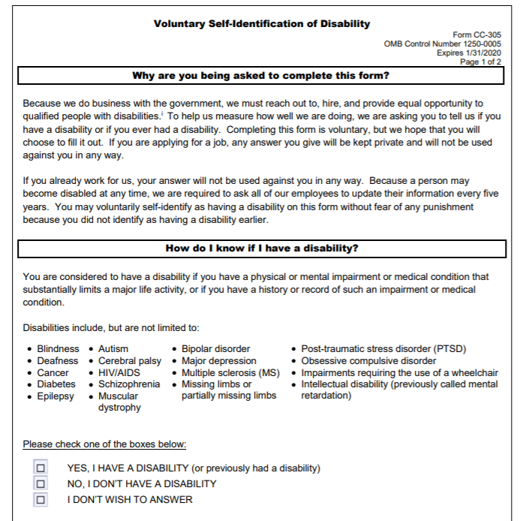
Self-Identification Form
A form for voluntary self-identification can be found at the OFCCP (Office of Federal Contract Compliance Programs) website at https://www.dol.gov/ofccp/regs/compliance/sec503/Self_ID_Forms/SelfIDForms.htm
The form asks if a person has a disability and includes a list of disabling conditions
States that employers must provide reasonable accommodations to qualified individuals with disabilities
Explains what reasonable accommodations are
Reminds employees to let employers know if they need reasonable accommodations to apply for or perform the job

Slide 7
Self-Identification Form
In addition, an employer:
Cannot force the applicant or employee to self-identify or ask for proof of the disability
Can ask if the applicant or employee if they have a disability, but cannot ask what the disability is
Cannot ask the applicant or employee to take a medical exam
The employer can ask whether the applicant can perform the essential functions of the jobs with or without reasonable accommodations
The employer must keep all self-identification information separate from other personnel records and cannot be available or used for any employment decision that could lead to adverse impact (such as hiring or performance review).

Slide 8
Data Collection
Section 503 requires federal contractors to maintain several quantitative measurements including:
The number of applicants who voluntarily self-identified as having a disability
The number of self-identified applicants who were offered a job
The total number of job openings
The total number of filled positions by those who have self-identified as individuals with disabilities
The number of current employees who have self-identified as individuals with disabilities once during the first year and at least every five years thereafter
Data assist contractors in measuring the effectiveness of their outreach and recruitment efforts
Department of Labor’s Office of Federal Contract Compliance Programs (OFCCP) monitors federal contract compliance with equal employment opportunities for individuals with disabilities

Slide 9
Outreach and Recruitment
Under Section 503, Affirmative Action Programs for federal contractors must include outreach and recruitment activities
Legislation suggests that contractors create partnerships with disability organizations to assist in finding and recruiting qualified applicants with disabilities. These organizations may include:
American Job Centers
State Vocational Rehabilitation agencies
Employment Networks and local disability organizations
The Department of Veteran Affairs
Disability services offices at universities and community colleges
Contractors should document all outreach, partnerships, and recruitment efforts and records should be kept for three years.

Slide 10
Questions?
Thank you.

