Slide 1
Motivational Interviewing: An Introduction
Justin Clark, MSW
Notes:
MI concepts are SIMPLE but implementing is not EASY and will take practice.

Slide 2
About Me
I have been a Counselor with IVRS in the Davenport office for about 4 ½ years. This is my third year of working almost exclusively with transition-aged youth in six Quad Cities High Schools and I am a member of the IVRS Motivational Interviewing (MI) Cadre.
MI captured my interest as an undergrad at the University of Northern Iowa in the early 2000’s due to its effectiveness and client centered nature. I sought additional expertise through the Master’s program at St. Ambrose University.
While living in England for several years, I was able to put into practice my MI training in serving youth with substance abuse issues who were leaving foster care. Upon my return to the States in 2009, I took a child welfare position with DHS, later transferring to DHS Targeted Case Management to work with Waiver services before beginning my position at IVRS in 2014. MI is and has always been an integral part of my work with clients, particularly with those “hard to reach” individuals.
Notes:
This video is meant to be an introduction to Motivational Interviewing. Hopefully there are some things that you can use immediately but if you are interested in learning more, check out the resources noted at the end and seek a full MI workshop if possible. My most recent workshop was with Dr. William Matulich in 2017. His presentation helped inspire much of what you’ll see today. You’ll find a link to his website and credits to his presentation at the end of this slideshow.
MI concepts are SIMPLE but implementing is not EASY and will take practice.

Slide 3
Definition of Motivational Interviewing
“MI is a collaborative, goal-oriented method of communication with particular attention to the language of change. It is designed to strengthen an individual’s motivation for and movement toward a specific goal by eliciting and exploring a person’s own arguments for change.”
Miller and Rollnick, 2013
Notes:
Dr. William Miller and Stephen Rollnick developed many of the founding principals of MI.

Slide 4
Why use Motivational Interviewing?
It is client-centered and empowering.
It honors autonomy and self determination.
It is more effective than confrontation, information and advice giving.
Increases buy-in of participants, leading to better plans and longer lasting changes.
It is evidence based.
Notes:
2. Humans develop a strong psychological need for autonomy early on. If this is not satisfied, the odds of achieving the desired result will be dramatically diminished. My three year old may lose his mind if I order him to pick up his toys or brush his teeth. How might that change when I ask him whether he’d like to pick up toys or brush teeth first? Providing the ability to choose the order in which the tasks are completed increases autonomy and both tasks are completed without incident.
Have you ever been in a job with very little autonomy? How motivated were you to work hard and stay on the job?

Slide 5
When can I use MI?
Any time you are charged with assisting someone to a behavioral change.
From intake to closure, MI can help us clearly define strengths and create achievable employment goals through partnership with the job seeker.
MI skills may be used with job seekers who are experiencing ambivalence toward change.
Could be particularly helpful with “difficult” cases where progress has stalled or regressed.
Notes:
MI was initially used in substance abuse treatment. It was observed to be an extremely effective way of assisting individuals with change and has since been adopted in many other professions including the medical field and Vocational Rehabilitation.

Slide 6
Today’s Working Definition of MI:
Motivational Interviewing is a collaborative way of exploring change with job seekers who are experiencing ambivalence.
Notes:
Change is hard! We don’t make changes until the discomfort of the status quo surpasses the discomfort of the proposed change. Our Job Candidates may come with reasons for and against their goal of finding employment. For instance, we may serve some individuals who are formally or informally mandated to participate in services.

Slide 7
Our own ambivalence about MI
“I’ve always done it this way, I don’t have time to learn a new way of communicating with my job seekers.”
“This is not applicable to my job.”
“This will not work with my difficult clients.”
“All of this talking will slow progress toward mandated deadlines.”
Notes:
The good news is that you are most likely already utilizing the basics of MI in your everyday work, so the changes will likely be less dramatic than you think.
“I am not a licensed mental health counselor” Nearly everyone working with job candidates from intake to closure can benefit from learning MI.
You may be correct, MI is not a magic bullet that will work with every job candidate. There may also be techniques that do not fit with your personal communication style. That is fine, feel free to pick and choose techniques that fit best for you and your job candidates.
While it is true that we are all beholden to agency deadlines, using MI up front is likely to create stronger plans for change. A bonus is that we as practitioners should feel less stress about creating change, as the onus us shifted to the job candidate.

Slide 8
Spirit of MI
Partnership: An active collaboration between two experts (yourself and the job seeker). Partnership is critical for change because neither is able to accomplish the goal on our own.
Acceptance: Promotes the job seeker’s autonomy and strengths.
Compassion: Promotes the job seeker’s best interests, prioritizing their needs.
Evocation: The job seeker has the knowledge, insight, and motivation inside themselves to make changes.
Notes:
Partnership: The counselor is responsible for creating a positive interpersonal relationship that creates a counseling environment that is conducive for change. A common error is when we think we have to provide all the “correct” answers to our job candidates when we may not have an answer at all.
Acceptance: Unconditional acceptance as the job seeker is today. It does not mean that you approve of the job seeker’s actions or behaviors. Our own personal approval or disapproval is irrelevant. Instead promote the job seeker’s autonomy, empathize and provide affirmations to the job seeker regarding their strengths and efforts. (Realize that the moment we attempt to change the client through “fixing” or “resolving” the problem, acceptance is halted)
Compassion: In the MI world, compassion is not a personal feeling. Their needs are the priority (we do not have our agenda) focus on what will be of value to them to decide if we are the right service.
Evocation: You must support the job seeker in identifying that they have the knowledge, insight, and motivation to make the change they want for themselves.

Slide 9
KEY SKILL- Empathy
Empathy is defined as the ability to understand and feel the emotions of another.
This allows us to acknowledge and understand the job seeker’s feelings about their current situation as well as the proposed change.
Helps us to better understand and deal with ambivalence throughout the process.
Notes:
NOT sympathy! You may understand why a person feels a certain way without feeling sorry for them.
Citation for dictionary.com?

Slide 10
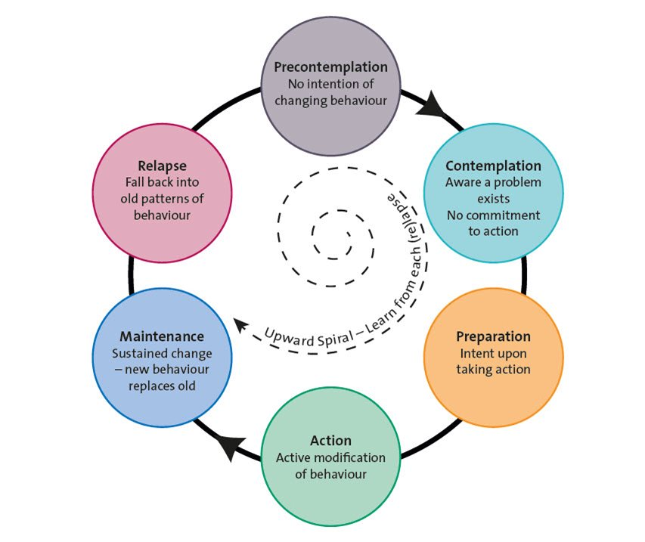
Stages of Change
Stages of Change (Prochaska, DiClemente & Norcross 1992)

Slide 11
Pitfalls to Avoid
Closed Question/Assessment Trap
Expert Trap
Premature Focus Trap
Arguing for Change Trap
Righting Reflex Trap
Notes:
Blocks exploration, promotes disengagement. Intakes/Assessments are unavoidable, do what you can to make it a conversation. “I’ve got some paperwork that we need to get done today but I’m sure that you have some things on your mind. Where would you like to start?”
Invites dependency, takes away the self-efficacy and autonomy that we are working to build. The expert may also feel that they end up working harder than their job seeker.
Halts exploration and ignores any ambivalence, which will trigger anxiety about the change and undermine commitment to the plan.
This evokes opposition and may inadvertently shame the job seeker.
This is our reflex to “make things right” when we see a problem, make everyone happy. We should instead be working to empower the job seeker to seek their own solution.

Slide 12
1. Pre-Contemplation
Not considering change and not interested in alternative action/behaviors.
Validate lack of readiness and encourage evaluation of current situation/behavior.
Ex: “You are an adult and you will be the one to decide if and when you are ready to start looking for a job.”
Notes:
Great opportunity to begin building rapport using empathy, OARS, etc. Build that environment for change! Be careful to avoid the common pitfalls.
“Find your why”
What concerns you about your current situation?
What is it about not being employed that others might see as a concern?
How has not working affected your life?

Slide 13
2. Contemplation
Ambivalent about change. “Sitting on the fence”. Not considering change in the near future.
Continue to validate lack of readiness. Encourage the exploration of the pros/cons of behavior change.
Ex: “I’m hearing that you are thinking about working, but you’re not ready to take action right now.”
Notes:
Example. Ambivalence is very high, great time for MI principles.

Slide 14
3. Preparation
Experience with change and are “testing the waters”. Planning to act soon, within the next month.
Identify and assist with problem solving obstacles to changing. Help identify supports in the individual’s life.
Ex: “It’s great that you feel good about your decision to work; you are hoping to make progress toward your goal of self-sufficiency.”
Notes:
“I really need to find a job, even if it isn’t my dream job. Do you think that there is a part time job out there for me?”
Consciousness raising
Feeling badly about present behavior/situation
Social Liberation – Opportunity to change
Self Re-Evaluation – “SSDI recipient to gainfully employed”
Self Liberation

Slide 15
4. Action
Individual has been practicing new behavior for 3-6 months.
Bolster confidence/self-efficacy for dealing with obstacles. Continue to focus on personal and social supports.
Ex: “What obstacles have been easy to overcome and what obstacles have been most challenging?”

Slide 16
5. Maintenance
Continued commitment to new behavior for longer than 6 months.
Reinforce internal rewards, discuss coping with relapses and continue to confirm personal and social supports.
Ex: “What has helped you to be so successful in maintaining this job?”

Slide 17
6. Relapse
Resumes old behavior patterns.
Evaluate triggers that contribute to old behavior patterns. Reassess motivation and barriers and emphasize past successes. Plan stronger coping skills.
Ex: “Has there been a time recently that you felt like skipping work but didn’t? If so, what kept that from happening?”

Slide 18
Essential Skills - OARS
Open-Ended Questions
Affirmations
Reflections
Summaries
Notes:
You will notice that these are really two distinct skills:
Open-Ended Questions
Affirmations, Reflective Statements and Summarizing Statements are all really forms of reflections

Slide 19
KEY SKILL - Equipoise
Equipoise with regard to MI refers to maintaining a balanced, non-judgmental approach throughout the working relationship.
Undue praise or disapproval can upset this balance and negatively impact this relationship.
Be wary of interjecting personal opinions and purposefully explore both pros and cons of change to maintain balance.
Notes:
Stay away from “I” statements.
If a job seeker feels judgement, either positive or negative, it will impact their progress toward change.
Keep your cool, particularly with job seekers who are reaction seeking.

Slide 20
Open-Ended Questions
Require something more than a “yes” or “no” response.
Allow the Job Candidate to provide details using their own words.
Help us learn about the Job Candidate’s values.

Slide 21
Closed vs Open-Ended Questions
“Are you here to register for employment services?”
1. “What brings you in today?”
2. “What do you already know about the services provided at our center?”
3. “What can Vocational Rehabilitation do for you?”
Notes:
Open ended questions help build rapport from our first contact. The closed ended question will move us toward the intake but the open ended questions will start a conversation and help us learn more about the job candidate’s circumstance and what is important to them.

Slide 22
Affirmations
Statements of appreciation used to build self-efficacy and empowerment (Can-do attitude).
Focus on describing strengths, resources, prior success, personal achievements, etc.
Maintain equipoise, avoid adding personal judgments with “I” statements.
Notes:
Equipoise is vital throughout the MI process.

Slide 23
Affirmation Statements
“You take great pride in working to support your family.”
“You’ve had success finding jobs in the past.”
“You have a good understanding of how your disability has impacted you on the job.”
Notes:
“You’ve shown courage in taking on this difficult problem.”
“Your frustration is understandable.”

Slide 24
Reflections
Help the job seeker feel listened to and understood
Empowers the job seeker as the expert and allows us to take on their perspective.
Allow us to gather more (and more accurate) information than we can with questions alone.
Notes:
Job seekers are going to be more open and honest regarding strengths, deficits and history if we build an effective partnership with our OARS skills.

Slide 25
Reflections
Simple
Repeat a statement from the job seeker.
Rephrase a statement using synonyms.
Complex
We may paraphrase, focus on the emotions behind the statement or exaggerate in order to garner additional information.
Notes:
I will talk more about using complex reflections in a few minutes. This is a great way to deal with ambivalence.
“It sounds like…”
“You are wondering…”
“If I’m hearing you correctly…)

Slide 26
Summaries
Can be used throughout any session to check for understanding and highlight discrepancies.
Collecting flowers (Change Talk) to form a bouquet.
End the summary with a closed ended question.
“Did I get it right?”
“Am I understanding correctly?”
Notes:
When you hear motivation for change, make a note of it and include it in the summary.

Slide 27
Summaries
Brief – “It sounds like you take pride in providing for your family. Not working has been difficult for you to bear, especially seeing how it impacts your wife.”
Wrap-up – “Your health has improved, so you decided to come in to see if returning to work is a realistic goal for you. Working is important to you because supporting your family financially will reduce the household stress. Is there anything that I left out?”
Notes:
There are many types of summaries and ways to highlight change talk within the session.

Slide 28
Ambivalence Toward Change
We may consider Ambivalence as a natural and predictable precursor to change.
In order to facilitate change an MI practitioner will explore ambivalence to reveal the job seeker’s internal motivation for the desired change.
Ballroom Dancing vs Wrestling – Do not oppose energy, gently redirect it in a productive way.

Slide 29
Sustain Talk vs Discord
Sustain Talk:
Recognizable as client speech that favors the status quo over moving toward change.
“I don’t need to find a job, I’m perfectly happy being unemployed.”
Discord:
Interpersonal behavior reflecting dissonance in the working relationship.
Behaviors may include arguing, interrupting, discounting or ignoring.
Notes:
Sustain talk is the opposite of change talk and will need to be explored further.
Discord lets us know that something is not functioning properly within the working relationship. Using our OARS techniques and seeking to better understand the job seeker’s position with genuine empathy is likely required before we can move forward.

Slide 30
Simple Reflections
Help define the resistance and buy time to plan your next intervention.
Job Seeker: “I am going to collect disability benefits until my dying day.”
Practitioner: “At this point you are going to collect disability benefits for as long as possible.”
Notes:
Statements of ambivalence can be shocking by design and a simple reflection can help maintain equipoise moving forward.

Slide 31
Amplified Reflections
Press the sustain talk, testing the client’s commitment to the previous statement
Job Seeker: “I am going to collect disability benefits until my dying day.”
Practitioner: “You don’t see any purpose in working.”
Notes:
The amplified reaction exaggerates the client’s statement. Their response will either confirm their commitment to the status quo or elicit change talk.

Slide 32
Double Sided Reflections
Compare the status quo to other statements that the client has made.
Job Seeker: “I’m going to collect disability benefits until my dying day.”
Practitioner: “For now you expect to collect benefits as long as possible AND on the other hand you recognize that you may change your mind.”
Notes:
Double sided reflections help to create discrepancy between current behavior and the client’s values/beliefs. Be sure to utilize AND instead of BUT to validate that both viewpoints may be held simultaneously.

Slide 33
Scaling Questions
On a scale from 0-10 how important is it for you to find work?
On a scale from 0-10 how confident are you in your ability to find work?
Notes:
Why are you at a ___ and not a zero?
What would it take to move you from a six to an eight?

Slide 34
Miracle/Magic Wand Question
“Suppose that a miracle takes place tonight and when you wake up, your most positive dreams have come true.”
What is the first thing that you notice?
What has changed?
Who is with you?
How does your family react to the changes?
Notes:
This technique can be used when a job seeker is so focused on problem talk that they are having trouble envisioning possible change.
Feel free to change the question as needed to fit your style or your job seeker. The goal here is to tap into a more creative, less burdened state of mind.

Slide 35
Better Days Question
“Do you remember a time when things were going better for you?”
What was different (with you, with the environment, etc.)?
What were you doing to overcome barriers?
How were you feeling at the time?
Was anyone else sharing in your success?
Notes:
This is a vague example.
We use past successes to build them up for positive changes. Remember, RELAPSE is also a stage of change and can be overcome using the job seeker’s strengths.

Slide 36
Decisional Balance Worksheet
1. 4.
2. 3.
Notes:
This is a wonderful tool to use when job seekers are perhaps not following through with expectations and spending the majority of the session using sustain talk.
The order is important.
If we can get the job seeker to come up with their own arguments for change, we can use their own words to help move toward employment.
Think about how this is different than you telling them

Slide 37
References
Clark, J., Galván-Ramos, P. Schwickerath, J. and Worden, L. (2016) Motivational Interviewing Toolbox [PowerPoint Slides]
Matulich, William (2017) Motivational Interviewing: An Introductory Workshop [PowerPoint Slides]
Miller, W.R. and Rollnick, S. (2013). Motivational Interviewing: Helping People Change. New York, NY: The Guilford Press.
Prochaska, J.O., DiClemente, C.C., Norcross, J.C. (1992). In search of how people change. Applications to addictive behaviours. Am Psychol 47:1102.
Rosengren, D.B. (2009) Building Motivational Interviewing Skills: A Practitioner Workbook. New York, NY: The Guilford Press.

Slide 38
Online MI Resources
Motivational Interviewing Network of Trainers
www.motivationalinterviewing.org
Stephen Rollnick’s personal website
www.stephenrollnick.com
Dr. William Matulich training website
www.motivationalinterviewingonline.com/Welcome.html

